Slide 1
Unlocking Minds: Harnessing Eyetracking Data for Cognitive Load Insights
Henner Bendig
Phillip Lamp

Slide 2
Introduction

Slide 3
Research Objectives
Goals:
Using (only) eyetracking data for the classificiation of cognitive workload¹
Neural network that outperforms traditional ML models on this problem
Challenges:
Most research is using traditional classifiers
May because of the elaborate data collection with human participants
Multimodal data is more accurate
People are different
¹ Cognitive workload: In cognitive psychology, cognitive load refers to the amount of working memory resources used.

Slide 4
Related Work
COLET [1] a dataset for COgnitive workLoad estimation based on Eye-Tracking
Monitored 47 individuals while solving visual search puzzles
After each puzzle, a NASA-TLX questionaire was answered
Tested with 8 classifiers: Gaussian Naive Bayes, Random Forest, Linear Support Vector Machine, Ensemble Gradient Boosting, K-Nearest Neighbor, Bernoulli Naives Bayes, Logistic Regression, Decision Trees
Fatique Detection in real time eye states [2]
Using pictures from a webcam of eyes in different states
Using the AdaBoost Algorithmn for binary classification (closed / open)
Testing the model in real-time car driving leads to 81,8 % accuracy
ML-Approach for detecting cognitive interference [3]
Collecting ET data while stroop test with different conditions, e.g. reading with interference / w.o. interference
Testing different ML Models to differ conditions
Model accuracies:
RF: ~63%
LR: ~59%
ANN: 68%
SVM: 68%
Notes:
NASA TLX: NASA Task Load Index, tool to rate perceived workload, developed from the NASA‘s Ames Research Center
[1] Ktistakis, E., Skaramagkas, V., Manousos, D., Tachos, N. S., Tripoliti, E., Fotiadis, D. I., & Tsiknakis, M. (2022). COLET: A dataset for COgnitive workLoad estimation based on eye-tracking. Computer Methods and Programs in Biomedicine, 224, 106989. https://doi.org/10.1016/j.cmpb.2022.106989
GNB Classifier high / low: around 88%
GNB Classifier: high / mid / low: 59%
[2] H. Wang, L. B. Zhou and Y. Ying, "A novel approach for real time eye state detection in fatigue awareness system," 2010 IEEE Conference on Robotics, Automation and Mechatronics, Singapore, 2010, pp. 528-532, doi: 10.1109/RAMECH.2010.5513139.
[3] Rizzo, A., Ermini, S., Zanca, D., Bernabini, D., & Rossi, A. (2022). A Machine Learning Approach for Detecting Cognitive Interference Based on Eye-Tracking Data. Frontiers in Human Neuroscience, 16. https://doi.org/10.3389/fnhum.2022.806330

Slide 5
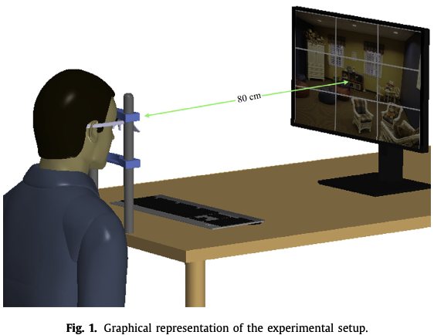
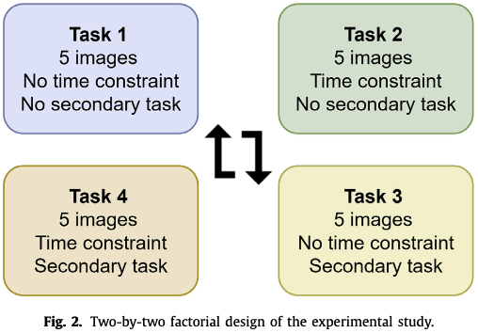
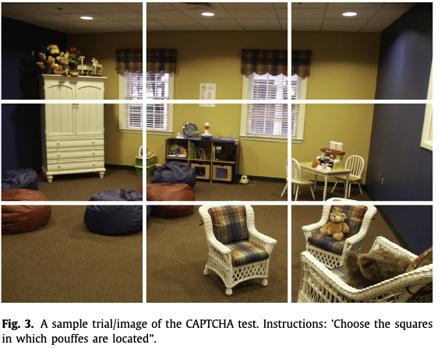
COLET Experimental Design

Slide 6
Data Overview

Slide 7
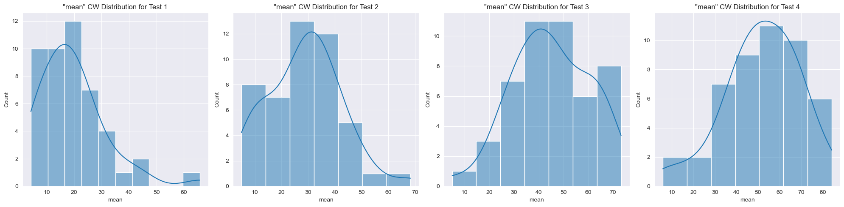
NASA Task Load Index (NASA-TLX)
Per Task a Questionnaire
Evaluates the „effort“ in different dimensions
Mental Demand
Physical Demand
Temporal Demand
Effort
Frustration Level
Scale from 0 (low) to 100 (high)
Mean-Value (prediction target)
Notes:
Mental Demand
How much mental and perceptual activity was required? Was the task easy or demanding, simple or complex?
Physical Demand
How much physical activity was required? Was the task easy or demanding, slack or strenuous?
Temporal Demand
How much time pressure did you feel due to the pace at which the tasks or task elements occurred? Was the pace slow or rapid?
Own Performance
How successful were you in performing the task? How satisfied were you with your performance?
Effort
How hard did you have to work (mentally and physically) to accomplish your level of performance?
Frustration Level
How irritated, stressed, and annoyed versus content, relaxed, and complacent did you feel during the task?

Slide 8
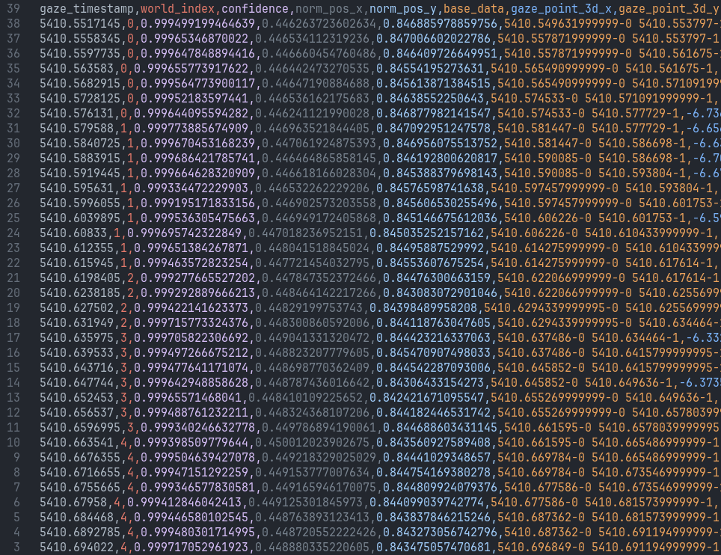
Original Dataset
Participant ID
Task ID
Time Series Data of blinks
Time Series Data of gaze points
Time Series Data of pupillary data
Demographic data
Age, Gender, Education, logMAR (value for poor eyesight)
NASA TLX Scores per test

Slide 9
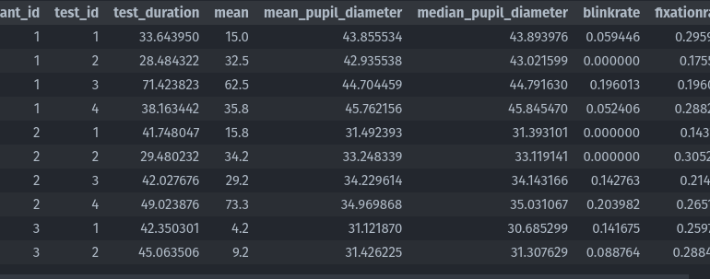
After Feature-Engineering
Participant ID
Task ID
Task duration
Demographic data
Age, Gender, Education, logMAR (value for poor eyesight)
calculated blinks/sec. + rel change
calculated fixations/sec. + rel change
calculated mean pupil size + rel change
Label: mean – cognitive workload

Slide 10
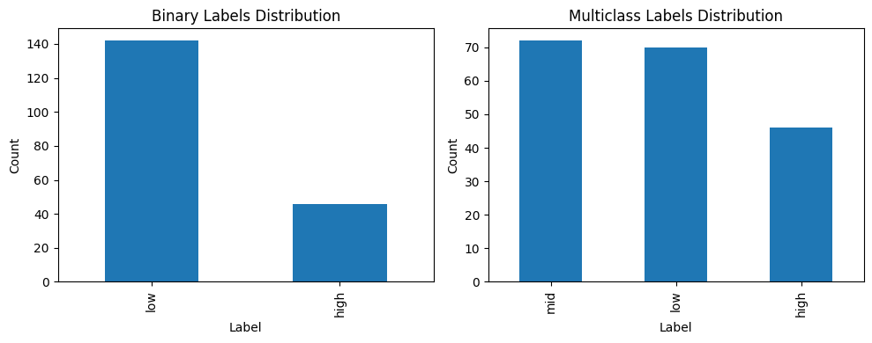
Resulting Data
47 Participants
Each with four Tests
188 datapoints in total

Slide 11
Approach

Slide 12
Generate New Data
Problem:
Not enough datapoints for accurate training
Idea:
use existing data create more synthetic data with the same properties
Approach 1:
Train a GAN (Generative Adversarial Network)
Approach 2:
Generate equally distributed data

Slide 13
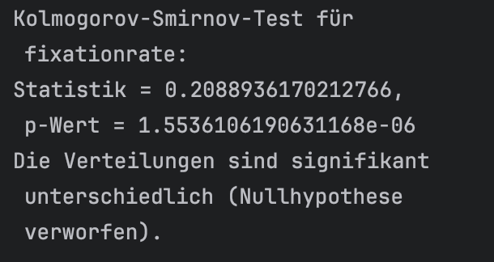
Example Fixationrate // Approach 1

Slide 14
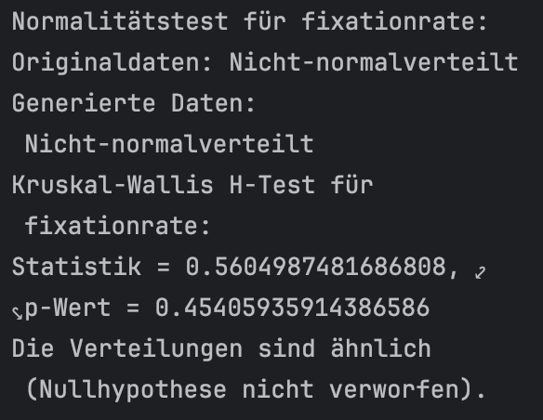
Example Fixationrate // Approach 2

Slide 15
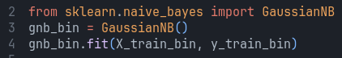
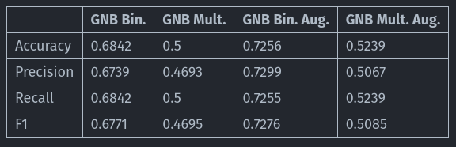
Classification – Baseline (GNB)

Slide 16
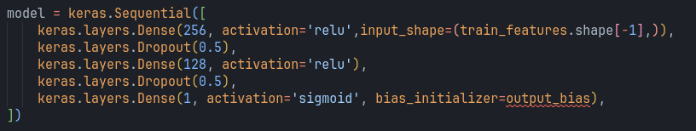
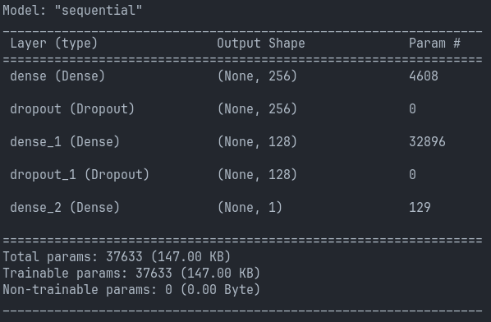
Classification – Neural Net

Slide 17
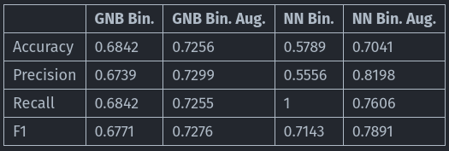
Classification – Neural Net

Slide 18
General Issues

Slide 19
General Issues
Understanding / working with provided dataset
Dataset only existing in pretty old matlab format
Feature Engineering took a while
Data augmentation pretty complex for this kind of dataset
Struggling with GANs / cGANs for gen. synthetic data
Time

Slide 20
Future Outlook

Slide 21
Future Outlook
More human participants (hard to realize)
Results working only for this kind of data
Use own experiments and own data-format
Model improvements
Hyperparameter Tuning
Architecture changes (more layer, regularization, etc.)
Dataset Improvements
Over/Undersampling to solve imbalances
Actually get cGAN working (might be not enough data)

